Slide 1
Screen Space Ambient Occlusion
Eugene Sturm

Slide 2
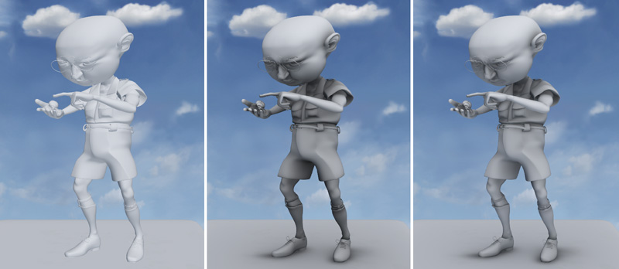
Ambient Occlusion
Approximation of the amount of ambient light that reaches a point.
Simulation of proximity shadows
Notes:
Soft shadows in corners and narrow crevices

Slide 3
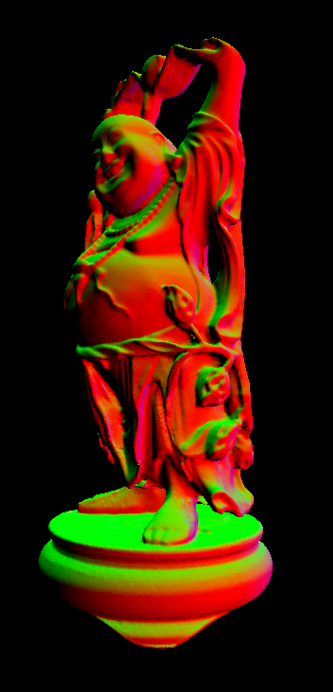
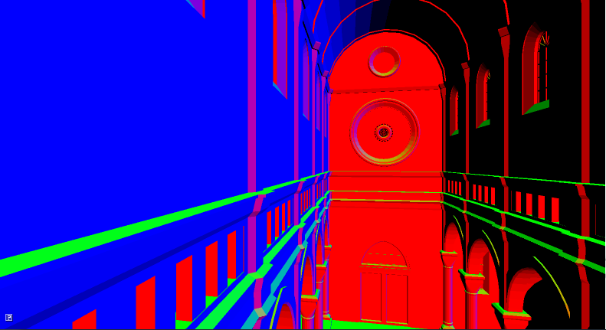
Method
Render the scene normals
and depth to a texture.

Slide 4
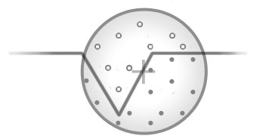
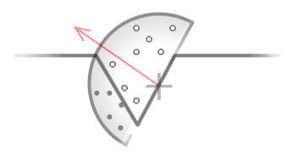
Method
For each target pixel, sample
surrounding points.
Prefer samples in the normal
direction

Slide 5
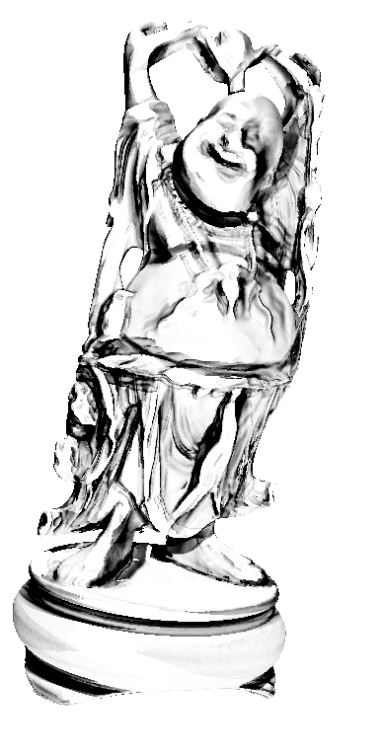
Method
At each target pixel, rotate
the sampling kernel to prevent
banding.

Slide 6
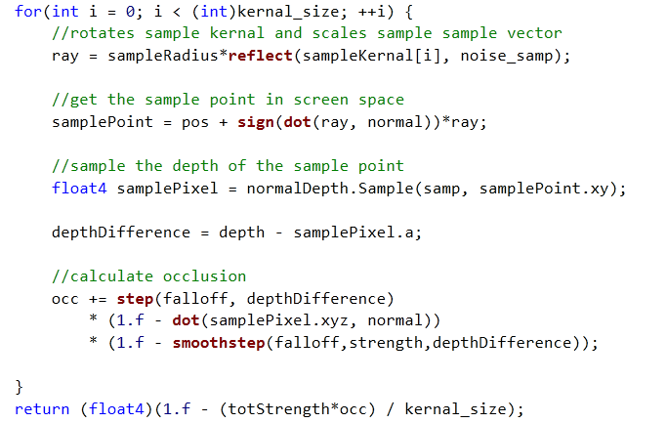
Method
Obtain sample vector and “rotate” sample kernel by reflecting against random vector.
Get sample point position from in screen space from the normal/depth map.
Accumulate occlusion per sample point.
Points in front of the target pixel don’t contribute
Points in the normal direction contribute more.

Slide 7
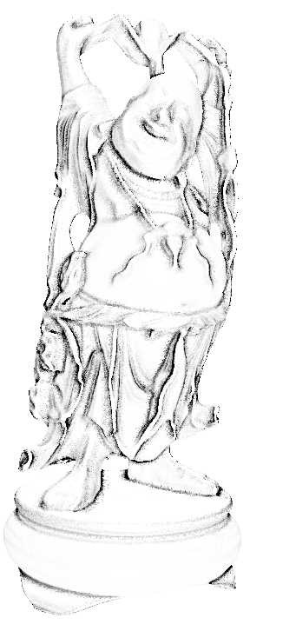
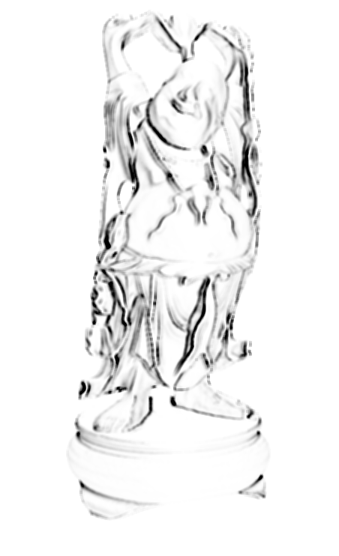
Method
Blur occlusion map
to reduce noise.

Slide 8
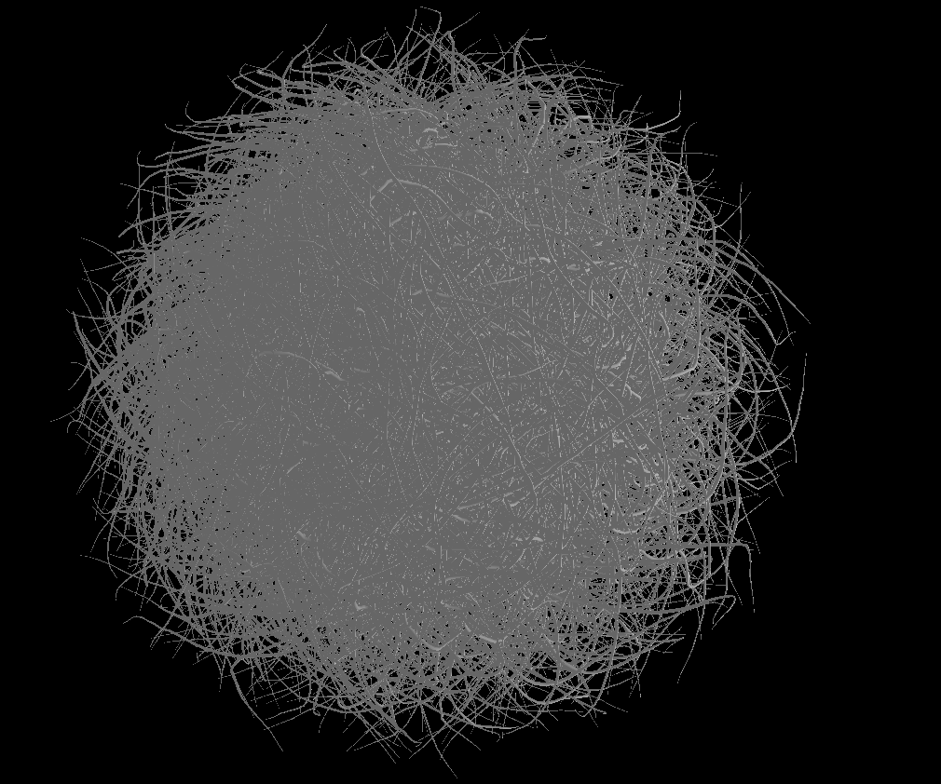

Slide 9
